Slide 1
Files and Menu Driven Programming
Nicholaus Hendrik Jeremy, S.Kom., M.Kom.

Slide 2
Learning Outcomes
LO 1 : Describe the fundamental concepts and purpose of information system analysis and design
LO 2 : Apply structured design techniques to model a system's logic and flow
LO 3 : Analyze system requirements to identify actors, processes, data, and interactions
LO 4 : Apply UML-based design artifacts to communicate a complete system solution

Slide 3
Outline
Menu-driven program
File concepts
Designing main & sub-menus
Linking menus to flowcharts

Slide 4
Menu-Driven Program

Slide 5



Menu-Driven Programming
Look at these examples. What do they have in common?
https://homepage.rs/en/blog-en/kako-da-tiktok-postane-deo-vaseg-digitalnog-nastupa/
https://www.businessinsider.com/instagram-redesign-with-reels-and-shop-2020-11

Slide 6
Menu-Driven Programming
Look at these examples. What do they have in common?
They have menu
https://homepage.rs/en/blog-en/kako-da-tiktok-postane-deo-vaseg-digitalnog-nastupa/
https://www.businessinsider.com/instagram-redesign-with-reels-and-shop-2020-11

Slide 7
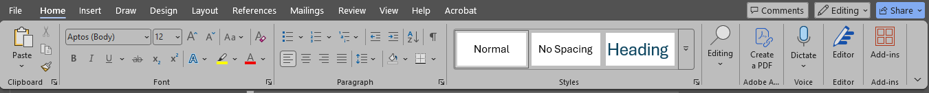
Menu-driven programming
Microsoft Word have ribbons and commands grouped within each tab. These categorization helps user with navigating around tools necessary to work with Microsoft Word.
Imagine if they are combined into one single tab. Several issues that will appear are:
Massive cognitive overload because everything is displayed at once. This in turn creates slower working pace, accessibility issue, and steeper learning curve.
This hefty number of features compiled into one means either the ribbons will occupy significant amount of space, or it has to occupy very small scrollable space. Both of which are still detrimental.

Slide 8
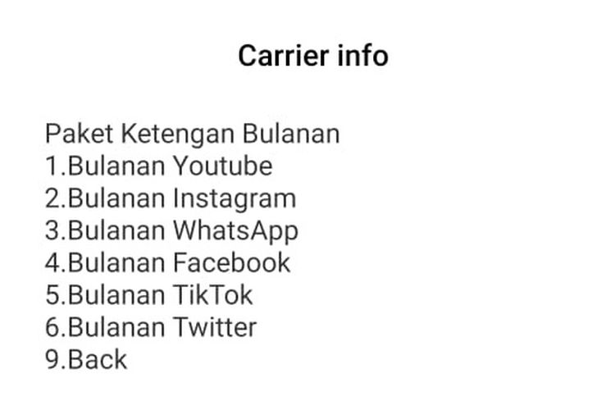
menu-driven programming
Although we understand the importance of menus using previous examples, they are all GUIs. Menu-driven programming focuses on using numbers to navigate through the offered services. One example of menu-driven programming is Unstructured Supplementary Service Data (USSD). Try it now: Dial your cellular provider’s USSD (*888# or *123# , etc.).

Slide 9
File Concepts

Slide 10
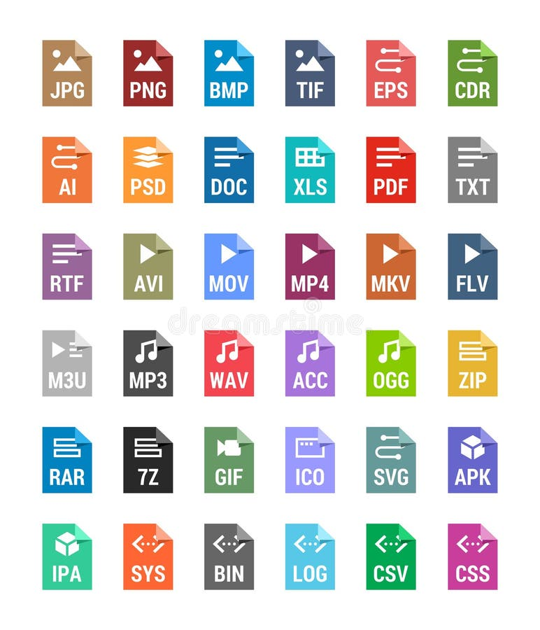
File Concepts
File within this context refers to how a program stores its memory. Various data types are popular to store information, such as CSV, JSON, YAML, DB, etc.
File is not bounded to full text with configurations. Even common file type is counted as storage: Images, Videos, Audios, and so forth.
https://www.dreamstime.com/stock-illustration-flat-file-types-icons-archive-vector-audio-image-system-document-formats-set-colored-image93717400

Slide 11
File Concepts
A storing system within the application must be consistent: it stores what it will receive. Any missing value caused by mishandling the file can result fatal.
These scenarios are possible thanks to data mishandling:
When your gaming account lost some of its IAP (in-app purchase)
When part of your investment in your mobile banking gone
When your transaction in online shop disappears (harmful to vendor)

Slide 12
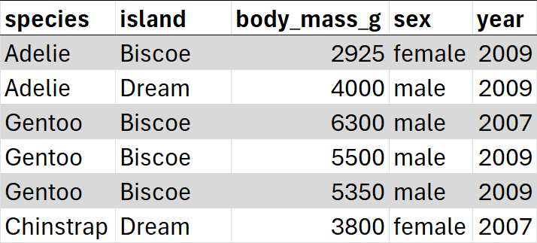
File Concepts
It’s best to think (even copy) what your data saves to create a load function.
“I need to store species, island, body mass(g), sex, and year”
“I must load species, island, body mass(g), sex, and year”
penguins.csv
10.5281/zenodo.3960218

Slide 13
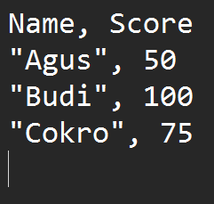
File Concepts
File name
Usually you will work with text-based data. Such data consists of several components:
File name: The name, including the extension, of the file
Header: The name of each column
Data rows: What is stored in the file
EOF: End of File
Tip: You can use the header as the variable name for your program, provided no varname conflict exists.
Header
data_mahasiswa.csv
Data rows
EOF
Notes:
It’s better for the header name to be more specific, e.g. “student_name”, “student_score”. This is to ensure that the concept of “name” can still be used somewhere else, e.g. for “lecturer_name”, “parents_name”, etc.

Slide 14
Accessing files
There are two types of accessing file: writing (save) and reading (load). It’s possible to do both within one process, but it’s best to separate writing and reading process. Either way, you will need to file name.
Both writing and reading have the same “logical flow”: (1) Declare the file variable, (2) Open the file using file name, (3) Process the file, (4) Close the file. Much like terminal symbol, open/close pair must exist in your flowchart. File processing is considered a process, therefore read/write uses rectangle shape.
For declaring the file variable, you can use Declare [InputFile/OutputFile] [Mode] [varname]. [Mode] is used for writing: WriteMode or AppendMode.
Declare OutputFile dataVar
Declare OutputFile AppendMode dataVar
Declare InputFile dataVar
Used for writing
Used for append
Used for reading

Slide 15
WRITING INTO FILE
When you are going to write into the file, follow the syntax:
Write [varname] [list of varnames that are going to be saved, separated by commas]
Start
data_mahasiswa.csv
Display “What’s the name and their score?”
Declare String Name
Declare Integer Score
Declare OutputFile dataVar
Input Name, Score
Open dataVar “data_mahasiswa.csv”
Write dataVar Name, Score
Close dataVar
End

Slide 16
Reading from file
When you are going to read the file, follow the syntax:
Read [varname] [list of varnames that are going to be read, separated by commas]
Start
data_mahasiswa.csv
Read dataVar Name, Score
Declare String Name
Declare Integer Score
Declare InputFile dataVar
Display “Name: “, Name, “, Score: “, Score
Open dataVar “data_mahasiswa.csv”
Close dataVar
End

Slide 17
Reading from file
You might notice that the read process is done once. This means, we only actually read ONE data row. We want to read ALL the data, and that’s where EOF comes into play. You don’t need to create the eof function.
Start
A
Declare String Name
Declare Integer Score
Declare InputFile dataVar
Means “There are still unchecked row(s) of data”
NOT
eof(dataVar)
True
Read dataVar Name, Score
Open dataVar “data_mahasiswa.csv”
False
Close dataVar
Display “Name: “, Name, “, Score: “, Score
A
End

Slide 18
Designing main & sub-menus

Slide 19
Designing menu-driven programming
When designing menus, there are several key importance:
Always numerate each option
Provide a way to get back to the menu AND exit the program
Handle invalid inputs by prompting the user to re-enter a valid option
Arrange options in a logical and intuitive order

Slide 20
Designing menu-driven programming
Always numerate each option
Since the only way to navigate through the menu is by number, numerating each option therefore becomes essential. Be consistent with your “back” or “exit” number. Usually, it’s 0, 9, 99, or placed as the last option.

Slide 21
Designing menu-driven programming
Provide a way to get back to the menu AND exit the program
Sometimes people make mistake, and it’s not a good experience to redo the input from the start, considering all the effort and waiting. Therefore, having a way to step back is important. Imagine all the work you need to do without undo shortcut.

Slide 22
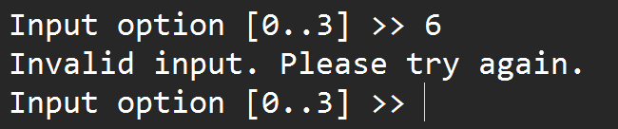
Designing menu-driven programming
Handle invalid inputs by prompting the user to re-enter a valid option
Sometimes the mistake can be something that cannot be processed because it’s not within the menu. Instead of terminating the program, ask the user to reinput the option. Better yet, ensure you tell the user the specific error instead of redisplaying the input prompt – this is to ensure that the user knows that an error had just occurred.

Slide 23
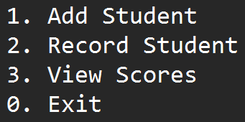
Designing menu-driven programming
Arrange options in a logical and intuitive order
In adjacent to UI/UX, a new user should be able to guess the right option without reading all of them. Making the menu more intuitive by organizing the menu that feels natural will accommodate the user more. This can be done through logical ordering and grouping.
Can’t add record if no student exist.
Repetitive, core function should be positioned early.
Can only be done after at least process no. 2 is done once, also rarely used menu.
Always placed last

Slide 24
Linking menus to flowcharts

Slide 25
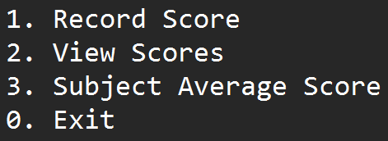
Linking menus to flowcharts
Keeping in mind the previous section, we can start making flowchart using the following structure:
Using module to simplify the flowchart
Using conditional loop for input validation
Using switch case for menu selection
Returning every submenu to the main menu

Slide 26
Linking menus to flowcharts
Using module to simplify the flowchart
Remember, module always use its name as the starting terminal…
displayMenu()
Since the menu can grow large, having a block of display can be space consuming. Instead, we can split them. This slide will show the module displayMenu(), whereas the next slide will show the main function.
Declare Integer menuOption
Display “1. Add Student”
Display “2. Record Student”
Display “3. View Scores”
Display “0. Exit”
… and uses Return as the ending terminal
Return menuOption

Slide 27
Linking menus to flowcharts
Using module to simplify the flowchart
main()
Declare Integer menuOption
menuOption = displayMenu()
With main function, we can use End terminal as is
End

Slide 28
Linking menus to flowcharts
Using conditional loop for input validation
A
displayMenu()
We have menuOption for our navigation. We will return that value, so we need to make sure it’s the acceptable value. Moreover, make sure the user knows the acceptable value and tell them when the input is wrong!
Declare Integer menuOption
Display “Enter option [0..3] >> ”
Display “1. Add Student”
Input menuOption
Display “2. Record Student”
Display “Invalid input. Try again.”
menuOption < 0
OR
menuOption > 3
Display “3. View Scores”
True
Display “0. Exit”
A
False
Return menuOption

Slide 29
Linking menus to flowcharts
Using switch case for menu selection
A
main()
Each case points to its own menu module
menuOption
Declare Integer menuOption
1
2
3
menuOption = displayMenu()
recordScore()
viewScores()
avgSubject()
A
menuOption != 0
True
False
End

Slide 30
Linking menus to flowcharts
Returning every submenu to the main menu
A
main()
If the menuOption is not 0, then the program goes back to the start
menuOption
Declare Integer menuOption
1
2
3
menuOption = displayMenu()
recordScore()
viewScores()
avgSubject()
A
menuOption != 0
True
False
End
The next slides will describe the shown module

Slide 31
Linking menus to flowcharts
recordScore()
A
recordScore()
Display “Enter Student’s Name: “
B
Declare String name
Declare String subject
Declare Integer score
Declare OutputFile AppendMode dataFile
Input name
Write dataFile name, score, subject
Display “Enter Student’s Score: “
Close dataFile
Input score
Open dataFile “scorelog.dat”
Return
Display “Enter Subject: “
A
Input subject
B
For brevity, validation is ignored here.

Slide 32
Linking menus to flowcharts
viewScores()
A
viewScores()
Declare String name
Declare String subject
Declare Integer score
Declare InputFile dataFile
Declare String nameFilter
NOT eof(datafile)
True
Read name, subject, score
False
name
==
nameFilter
Open dataFile “scorelog.dat”
False
Close dataFile
Display “Input student’s name: “
Return
True
A
Display “Subject: “, subject,
“; Score: “, score
Input nameFilter
It is assumed we can filter by student’s name

Slide 33
Exercise
Try to finish the submenu “avgSubject()”. The submenu will ask for the subject name, and you must calculate the average score of the inputted subject. You can assume the user input is always correct, so no user verification needed for this submenu.

Slide 34
References
Gaddis, T. (2022). Starting Out with Programming Logic and Design 6th Edition.
ISBN: 9780137602018 / 9780137602148

Slide 35
Thank you

